Slide 1
Movie Recommendation System
Team Outliers :
Harika Nalam
Rajvi Shah
Sharad Nataraj
Shreya Nimbhorkar

Slide 2
Introduction
With OTT platforms being the new way of watching content, a lot of content is hosted on a single streaming service.
The user has to search for specific content among a large collection of movies.
To solve this problem, a recommendation system can be used.
Based on the user profile, recent views and the content of the movie, the system recommends movies that are more towards the interest of the user.
The system works based on a model trained using already existing data.

Slide 3
DataSet Description
The Movielens dataset has been taken from the Grouplens organization. The dataset contains multiple files such as :
Ratings.csv - The file ratings.csv contains all of the ratings. After the header row, each line in this file represents one user's rating of one movie, and has the following format:
userId,movie,rating,timestamp
Movies.csv - Movie information is contained in the file movies.csv. Each line of this file after the header row represents one movie, and has the following format:
movieId,title,genres
Links.csv - The file links.csv contains identifiers that can be used to link to various sources of movie data. After the header row, each line of this file represents one movie and has the following format:
movieId,imdb
Id,tmdb
Tags.csv - All tags are contained in the file tags.csv. Each line of this file after the header row represents one tag applied to one movie by one user, and has the following format:
userId,movieId,tag,timestamp

Slide 4
Implementation details
Content-Based Filtering
Collaborative Filtering
Memory Based collaborative filtering
Item-Item Filtering
User-Item Filtering
Model Based collaborative filtering
Single Value Decomposition
Session Based Recommendation Using HRNN with AWS personalize(State of Art)

Slide 5
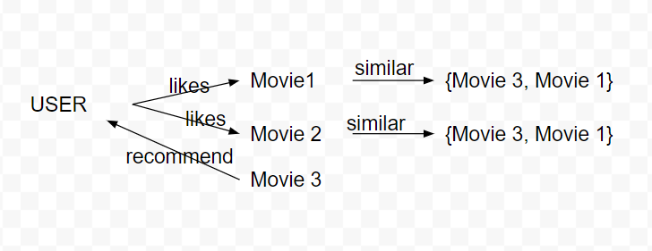
Content-Based Filtering

Slide 6
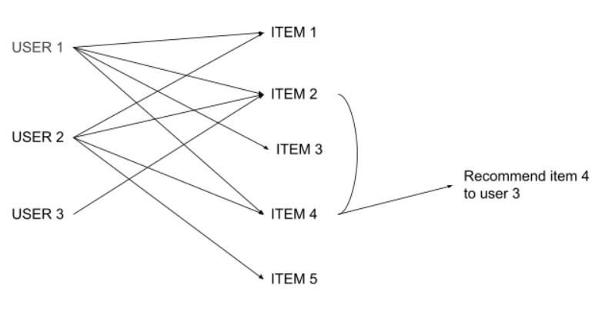
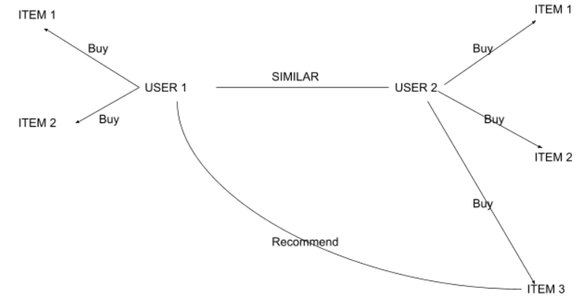
Memory Based Collaborative Filtering
Item-Item Filtering
User-Item Filtering

Slide 7
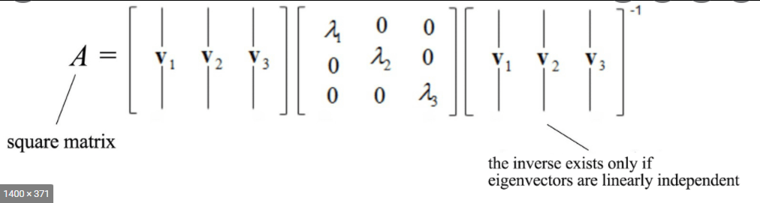
Model-Based Collaborative Filtering
Single Vector Decomposition:

Slide 8
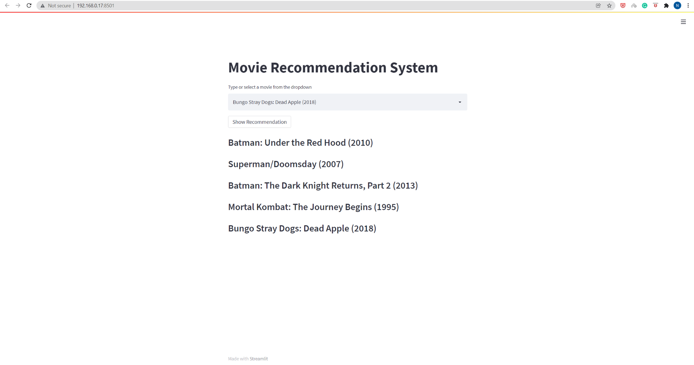
Movie Recommendation through API

Slide 9
Session Based Recommendation Using HRNN with AWS personalize(State of Art)
(State of Art)
Format input data and upload the data into an Amazon S3 bucket, or send real-time event data.
Select a training recipe (algorithm) to use on the data.
Train a model (called a solution version in Amazon Personalize) using the recipe.

Slide 10
Additional Features
Amazon Personalize makes it simple for developers to create apps that provide a variety of personalization experiences, such as personalized product recommendations, personalized product re-ranking, and customized direct marketing.
Amazon Personalize is a fully managed machine learning service that goes beyond rigid static rule-based recommendation systems and trains, tunes, and deploys custom machine learning models to deliver highly personalized recommendations to customers across industries like retail and media and entertainment.
Amazon Personalize provides the required infrastructure and controls the complete machine learning pipeline, including data processing, feature identification, application of the best algorithms, and model training, optimization, and hosting.
Wel get results using an Application Programming Interface (API), and all information is encrypted for privacy and security, and it is only used to generate suggestions for your users.

Slide 11
Thank you!!

